Slide 1

Jira Software
Get Started with Jira Software
Notes:
Jira is a software development and management tool. Its from Atlassian, an Australian company.
Jira helps you to schedule and record your work, helps you to manage project pipelines, report to fix bugs.
So we can say it is a software project management tool as well.

Slide 2


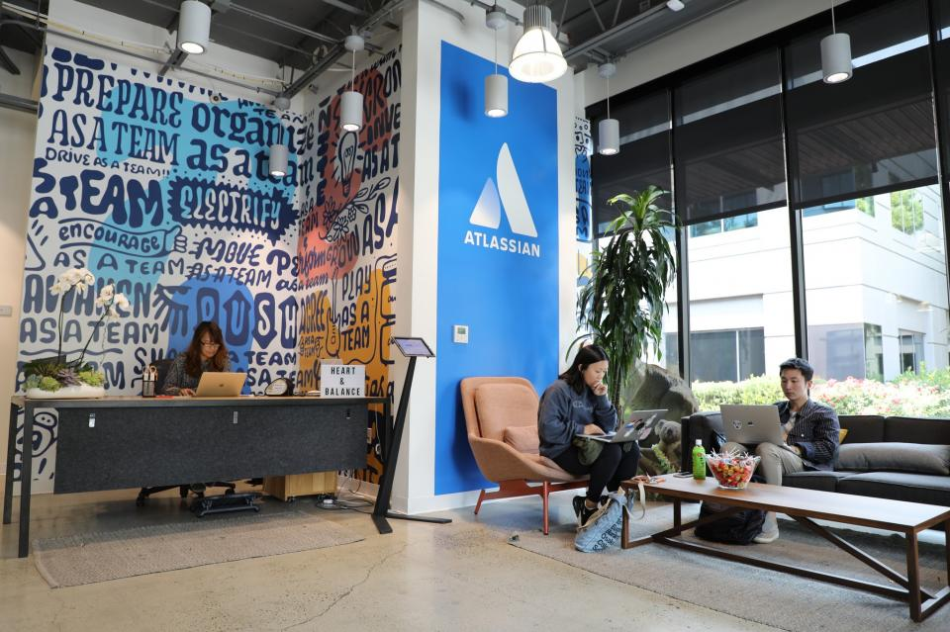

Atlassian Offices
Sydney (HQ)
San Francisco
Mountain View
New York City
Manila
Sydney
Bengaluru
Austin
Amsterdam
Yokohama
Boston
Ankara
Notes:
This is how Atlassian offices look like.
The name Atlassian comes from greek mythology the name of Titan Atlas.
It develops products for software development, project management and content management.
Nowadays work from home is populer. So this tools are very useful and
There are many tools for management, like Monday.com, Click up, trello, Asana, Zoho Projects. and many many more.
But among all jira software is the most common one for scrum teams
Jira and other tools comparison
https://www.atlassian.com/software/jira/comparison
Anyway Jira is the main product of the Atlassian Company.
It is founded in 2002. Now Atlassian $40 billion valued company.
And It is best known for the issue tracking applications like JIRA .
It is a project management tool used by thousands of companies and organisations
including NASA and Tesla.
Now Atlassian has nearly 200,000 (two hundred thousand) customers and
It has nearly 5000 employees.
It has offices in 7 countries. The headquarter is in Sydney.
There is an interesting thing;
They say there are 2 planets that they have their software on.
Atlassian is on two planets
What does it mean ? On the earth and on Mars.
in 2012, It was used in NASA's Mars program. Curiosity I think.

Slide 3

Atlassian Company
Notes:
Now let’s watch a short video about Atlassian

Slide 4
Table of Contents
Introduction to Jira
Jira Products
Jira Software Hosting Options
Setting up Jira Software Cloud
Navigating in Jira
Jira Concepts
Jira Integrations
Notes:
WeI'll check Jira and different Jira products and hosting options.
We will talk about setting Jira Software Cloud.
You'll also get to know navigating in Jira.
Today for you there is no hands on. Just sit back and enjoy the lesson.
But, Next week together we will create a project roadmap, create epics and stories
and also we will plan sprints.
Today we’ll cover in theory, next week we’ll make some practice.

Slide 5
Introduction to Jira
1

Slide 6
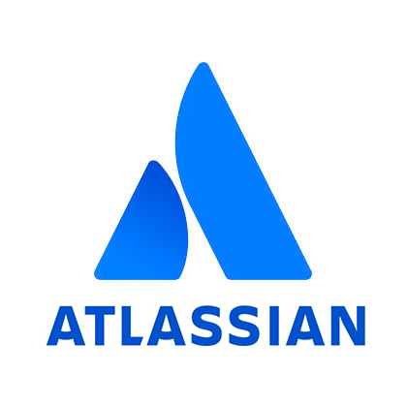


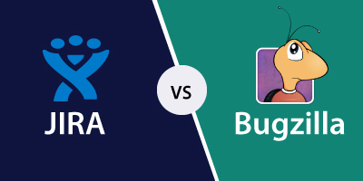

What is Jira?
Project Management
Issue Tracking
Bug Tracking
Notes:
Jira is a tool developed to assist teams in project management, It is also for issue tracking and software bug tracking,
What is issue? Issue is work to be done. It is a ticket in Jira.
Jira is widely used by large companies in software development and software testing.
The name "Jira" comes from the abbreviation of Gojira, It means Godzilla. in Japan they call Gojira. It refers to the rival Bugzilla.

Slide 7


What is Jira?
A tool used to help teams perform, visualize and manage work.
Models the team’s current processes/workflows.
You can open tickets or issues and push them through various statuses in your processes
Notes:
When Jira was launched in 2002, it was seen as an issue tracking software used by software developers.
Later, this application was accepted as a project management tool.
And software companies and also other organizations began to use it.
You can create your business-based processes into digital boards and open tickets or issues.
You can change their statuses.
“To do”, or “in progress”, “Completed”, those are the status of a task.
Do you remember kanban board?
There are columns, (remember from scrum or kanban board)
Actually the columns shows the status of the tasks.
So You can see your workflows in Jira.
As they are used in agile project management you can think that jira is a tool only for scrum and kanban,
but you can use it in any company and in any project. Not only in software development

Slide 8



Why Jira?
Leverage project management technology, allowing teams to focus on their work.
Facilitates planning, prioritizing, organizing and completing work.
Visualizes work using project boards, reports and dashboards.
Facilitates team communication.
Notes:
Why Jira?
First of all, it allows teams to focus on their work.
Makes it easy in planning, organizing and completing work.
Using project boards, reports and dashboards, it makes everything visual
You can also communicate with your team with Jira.
As a summary
You can;
Schedule and record your work,
manage project pipelines,
You can report and fix bugs,
You can create issues -
report time and monitor progress,
You can track changes and tasks, and
keep all the records. So you can have a history of your project.

Slide 9
Who Uses Jira?
Jira Software launched in 2002 as an issue tracking and project management tool for teams.
65K+
More than 65,000 companies around the world rely on Jira Software to manage their projects.
Teams of 2 through 2000
Jira is used by teams of 2 - 2000 people in companies of all sizes.
Notes:
Who uses jira?
We will talk about the teams and companies that use Jira.
Not only software teams use it, any company can use it.
Now, more than 65,000 companies have used Jira.
Why it is so popular ?
Because It works with the flexibility to support all kinds of projects and
it helps in thousands of applications and integrations.

Slide 10






Who Uses Jira?
financial services
retail
software
high-tech
automotive
government
non-profit organizations
Notes:
Jira Software is a tool that can help teams in financial services, retail, software,
high-tech, automotive, non-profit organizations, government, and many more industries.
These organizations work productively as organized with Jira.
If your team has a project to complete, you can use Jira Software to manage it.
The beauty of Jira Software is that it can be configured to suit any project,
from simple task management to highly complex enterprises.

Slide 11








Who Uses Jira?
financial services
retail
software
high-tech
automotive
government
non-profit organizations
Notes:
Some companies that use Jira;
CARFAX is a virginia-based company.
It provides vehicle history reports for used cars and trucks for American and Canadian consumers.
Autodesk is a US company that develops professional software for industrial use.
It contains the most used industrial software in the world.
Autodesk is also known for being one of the top software code generators.
Do you know the name of that most used software?
It is Autocad.
Cancer Research UK conducts research as the world's largest independent cancer research charity.
Audi is a German automobile company also uses jira.
The Telegraph is a national British daily newspaper uses it.
ANZ is the largest New Zealand bank, not surprising.
Domino's Pizza is an international pizza delivery company also uses jira.
Before you ask I give the answer:
SpaceX is a very big company
An example of an Agile development platform Jira, Confluence and BitBucket, Soho Helpdesk.

Slide 12
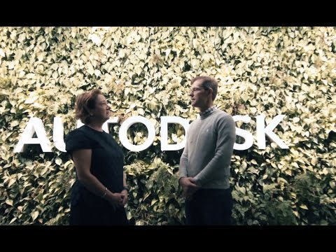
JIRA Customer Story
Notes:
Now we will watch the audi video.
Since the introduction of AutoCAD in 1982,
Autodesk has been a leader in 3D design, engineering and entertainment software.
Today, Autodesk's product portfolio includes more than
100 products available in 18 different languages.
--------------------------
Autodesk has over 100 engineering teams,
and each group has a unique process for software development and delivery.
Peter Jones is senior manager of operational excellence at Autodesk. He says:
“It is very difficult to maintain documentation and process flow between all those teams,”
He states that they overcame this with Jira.

Slide 13


Jira is only used by software development teams.
Notes:
🍐 This is a Pear Deck Multiple Choice Slide. Your current options are: A: True, B: False,
🍐 To edit the type of question or choices, go back to the "Ask Students a Question" in the Pear Deck sidebar.
What is your answer
false, right?
software developers use ok but business people also use it.

Slide 14

Have you ever used Jira before?
Has your company used Jira products?
Notes:
Summarize
Have students write a quick, 1-2 sentence summary of the information they’ve just learned.
🍐 This is a Pear Deck Text Slide
🍐 To edit the type of question, go back to the "Ask Students a Question" in the Pear Deck sidebar.
Lets check your answers

Slide 15
Jira Products
2

Slide 16
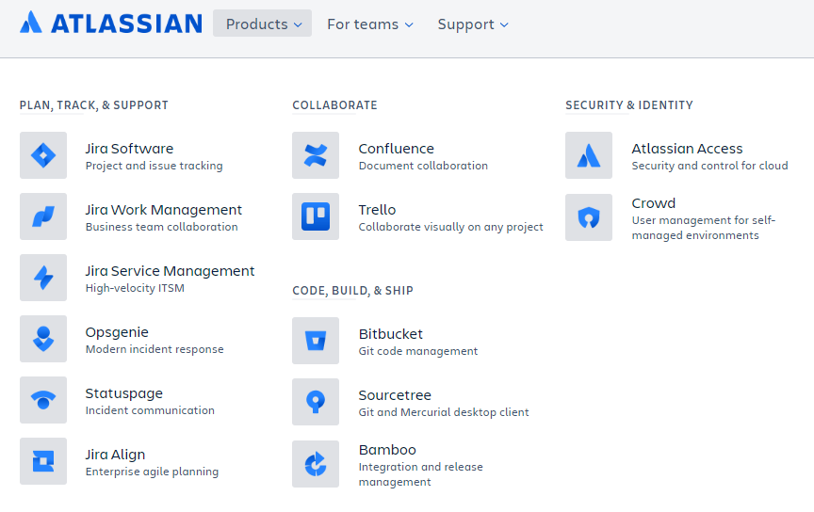
Atlassian Products
Notes:
Atlassian has many products.
You can see them in atlassian https://www.atlassian.com/
PLAN, TRACK and SUPPORT products:
—--------------------------------------------------------
This four is called jira family. We will check them in the next slide.
Jira Software : Jira is used for issue tracking and project management by over 180,000 customers in 190 countries
Jira Work Management : is intended as generic project management for large scale enterprises.
Jira Service Management : is intended for use by IT operations or business service desks.
Opsgenie : is essentially a problem management tool that receives alerts from your monitoring systems
and custom applications than gives a category for each alert according to importance and timing.
StatusPage : is a communication tool that helps you inform your users about outages and scheduled maintenance.
Jira Align : is intended for strategic product and portfolio management
COLLABORATION TOOLS
—--------------------------------------------------------
Confluence: is a content collaboration tool developed for teams. It is for documentation.
In Confluence, content is created using spaces, pages and blogs.
Trello: Is a lightweight web based project management application.
It was bought by Atlassian company for more than 400 million dollars in 2017.
SECURITY AND IDENTITY products:
—--------------------------------------------------------
Crowd:, is an application security framework that provides authentication and authorization for your web-based applications.
Atlassian Access: is an security and management tool in all Atlassian cloud products.
CODE AND VERSION MANAGEMENT:
—--------------------------------------------------------
Bitbucket: Is a web-based version control repository hosting service, like github, Atlassians github solution.
Sourcetree: Is a powerful Git desktop client for developers using Mac or Windows.
Bamboo: is a continuous integration and continuous distribution server.
I think devops teams use bamboo. It is a tool Like Jenkins (open source build, test, deploy)
The tools that we don’t see in the slide:
Fisheye is a revision control browser and search engine
Crucible is a collaborative code review application.

Slide 17



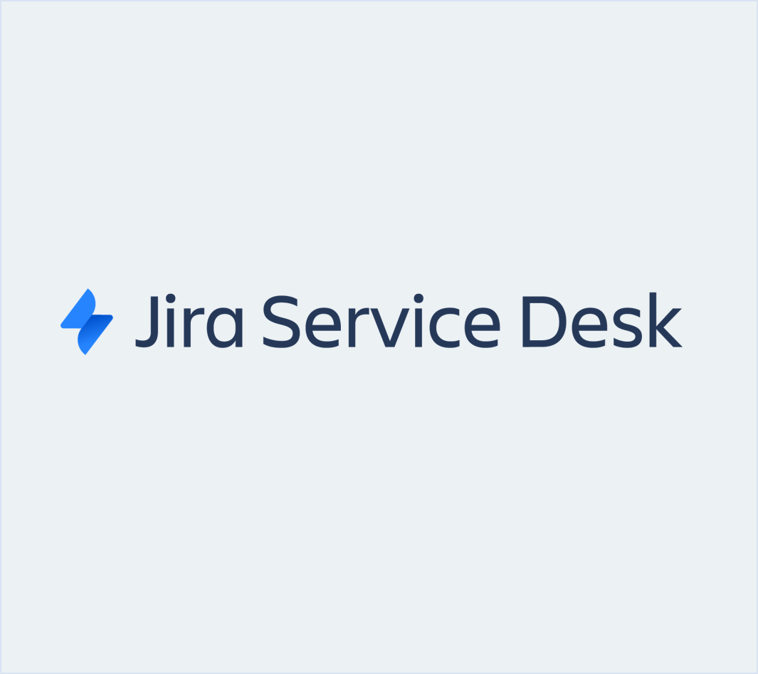


Jira Family
PLAN, TRACK, & SUPPORT
Agile Teams
Software developers
Large organizations
Business users
Service desk agents
Jira Software
Notes:
PLAN, TRACK AND SUPPORT products
Jira is built for teams to manage their projects and track their work.
Jira Software, Jira Align, Jira Service Desk, and Jira Core.
Depending on the type of your teams and what you're looking to accomplish, preferred tools may differ.
Jira Software is used by software development teams to plan, track, and release software.
Jira Service Desk is used by IT and Customer Service teams to create and run their service desks.
Jira Core (Jira Work Management, overhauled) is used by business teams like Finance, Marketing, and HR
to manage projects and keep their teams organized.
Jira Align: is for large organizations, for scaling their jira products, large companies use jira align.
Agile teams uses Jira software.

Slide 18
Jira Family
Product | Description
Jira Software | This is a software development tool used by agile teams (formerly known as JIRA Agile). It is very suitable for software development teams who want to use agile methodologies such as Scrum and Kanban.
Jira Align | Jira Align is a member of the Jira family which allows the company leadership to monitor current developments and link them to business outcomes at an enterprise scale.
Jira Work Management | This is similar to the classic Jira, optimized for business teams, with all the field customizations and workflow capabilities. Jira Work Management keeps the teams organized by managing projects, monitoring details, and measuring performance.
Jira Service Desk | Jira Service Desk is a modern IT service desk software that can run on the cloud or server. With this product, service desks can easily receive, monitor, manage and resolve the requests from customers.

Slide 19

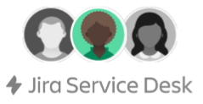

What You Can Do in Jira?
It depends on what role you have in your organization
Scrum Master
IT Manager
HR Manager
Creates and manages sprints
Creates SLAs and request types
Creates reports
Notes:
We can use jira but according to our job title, tasks, permissions and our limitations will be different.
Development team uses jira software.
The whole software development team has access to Jira Software to manage their projects
but only scrum masters can create and manage sprints.
Scrum master creates tickets for next sprint and pushes them to the team member.
Development team members can write your comments, add some documents to those task, to those tickets.
Support team, you have access to Jira Service Desk to run help desks
IT Managers can create (SLA) Service Level Agreements and request types.
Service level agreement = A service-level agreement (SLA) is a commitment between a service provider and a client.)
Business Team, you use Jira Core (Jira Work Management) to manage tasks, only managers can create reports.
If you are not in a scrum master or project manager role you don’t create epics, you don't create sprints in jira.
You just get jira tickets about your tasks, and you can follow the whole project process from jira.
Even if we won’t have to do so, we will learn how to create tasks and sprints in Jira.

Slide 20

Select the right Jira Product for the following use case.
Helping cable customers with a Help Desk
Notes:
🍐 This is a Pear Deck Multiple Choice Slide. Your current options are: A: Jira Software, B: Jira Service Management, C: Jira Work Management,
🍐 To edit the type of question or choices, go back to the "Ask Students a Question" in the Pear Deck sidebar.
Jira Service Management

Slide 21

Select the right Jira Product for the following use case.
Creating a Rental Car app
Notes:
🍐 This is a Pear Deck Multiple Choice Slide. Your current options are: A: Jira Software, B: Jira Service Management, C: Jira Work Management,
🍐 To edit the type of question or choices, go back to the "Ask Students a Question" in the Pear Deck sidebar.
Another question here.
Jira software

Slide 22
Jira Software Hosting Options
3
Notes:
Jira is a web based application, therefore several hosting options are available.

Slide 23
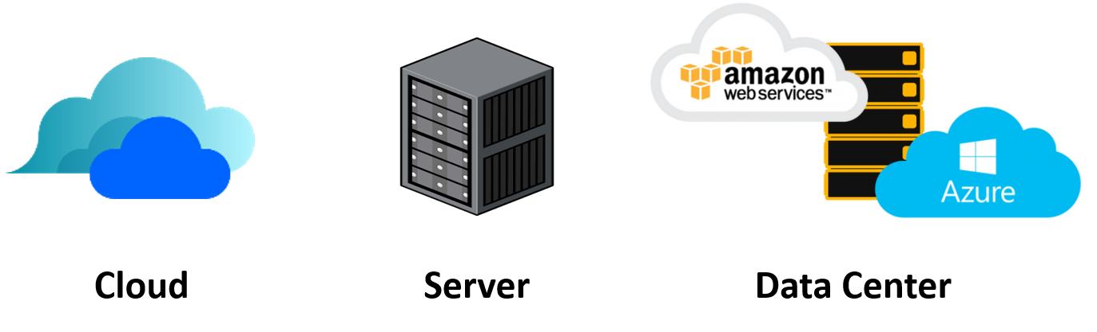
Hosting Options
Self-managed Options
Notes:
Jira Software is basically offered to you in two hosting options:
1] in Cloud in Atlassian hosts.
2] Self-management option.
Briefly Atlassian offers, whether you use Atlassian online services, or you deploy it yourself somewhere, just like Bonobo Git Server alternative to using Github.
In the cloud option you use Atlassian servers and you don’t need to download and make any setup.
For the self-management option, there are also 2 options;
You can download setup to your own server, your own hardware.
Your own server means your company has a data center and servers.
Company locally operates its servers.
https://www.atlassian.com/software/jira/update
And you can use data centers of public cloud services like AWS and Microsoft Azure
Actually this is not our issue this is an administrative issue of the company.

Slide 24

Atlassian Cloud
Fast start-up
Reduced costs
With Jira Software Cloud, the Jira Software site is hosted and installed in the cloud for you.
This hosting option is usually preferred by the teams who want to get started quickly and practically.
Thus, agile teams are free from managing the technical complexity of the hosting process.
No need to upgrade
Work on the go
Security
Scale with confidence
Notes:
With Jira Software Cloud, the Jira Software site is hosted and installed in the cloud for us.
This is often the best option for teams that want to get started quickly and easily,
and for teams that don't want to manage the technical complexity of hosting.
There are some advantages:
quick launch --- As soon as you sign up, you can start working and inviting team members.
low cost --- You save on physical hardware, maintenance, installation and support, and other management costs.
no need to upgrade --- you get instant access to the latest and greatest features, no work required.
Working on the go --- Cloud products allow teams to take their work anywhere and can be safely accessed from any browser or mobile apps.
security ---- the provider monitors and protects your information.
Scale with confidence --- Responds immediately to dynamic increases in demand and team growth.
An interesting detail, Atlassian actually uses AWS.

Slide 25

Server
Want advanced control
Need data locality
Have experience with self-hosted applications
Jira Software Server allows you to host Jira Software on your own hardware and customize it to suit your needs when installing.
This is often the best option for teams that have experience with self-hosted applications and need to manage all the details.
Notes:
Self hosting option :
We install, host and run the products on your own hardware.
We can customize your setup as you wish.
If the company wants more control and If it is necessary to keep data locally: you can choose this option.
There will be an Important change ;
Atlassian has ended sales for new server licenses and will end support for server option on February 2024.
And instead of this option they advice to use public cloud data centers.

Slide 26
Data Center
Maintain uninterrupted access to Jira Software
Scale to meet their organization’s demand
Upgrade with zero downtime for easier administration
With this option, Jira Software can be hosted on your hardware or public cloud services such as Amazon Web Services (AWS) and Microsoft Azure.
Jira Software Data Center is often the best deployment option for enterprise teams that need uninterrupted access and high performance.
Notes:
With this option, Jira Software can be hosted on public cloud services such as Amazon Web Services (AWS) and Microsoft Azure
in this option you don’t need to worry about technical issues of running a data center.
Because you use AWS or azure cloud infrastructure.
As we mentioned before Atlassian’s online Jira Services itself is deployed on AWS as well.

Slide 27
Atlassian Web Site
5
Notes:
We will navigate in Atlassian web site.
We will see Agile page.
talk about agile, scrum,
https://www.atlassian.com

Slide 28
Setting up
Jira Software Cloud
4

Slide 29


Have you created your Jira Software Cloud site?
Notes:
🍐 This is a Pear Deck Multiple Choice Slide. Your current options are: A: Yes, B: No,
🍐 To edit the type of question or choices, go back to the "Ask Students a Question" in the Pear Deck sidebar.
Have you created your Jira Software Cloud site?
do you have an account in Atlassian

Slide 30


Setting up Jira Software Cloud
Go to the Atlassian website.
Select the Jira Software option.
Decide which plan is right for you.
Create your Atlassian account.
Personalize your experience.
Invite your team.
Answer questions to Recommend a Project.
Choose a template.
Create project.
Notes:
Lets use Jira Cloud option to check the features of Jira.
We don’t need to worry about the installation phases actually, that was only for checking the options.
Up to ten people it is free.

Slide 31
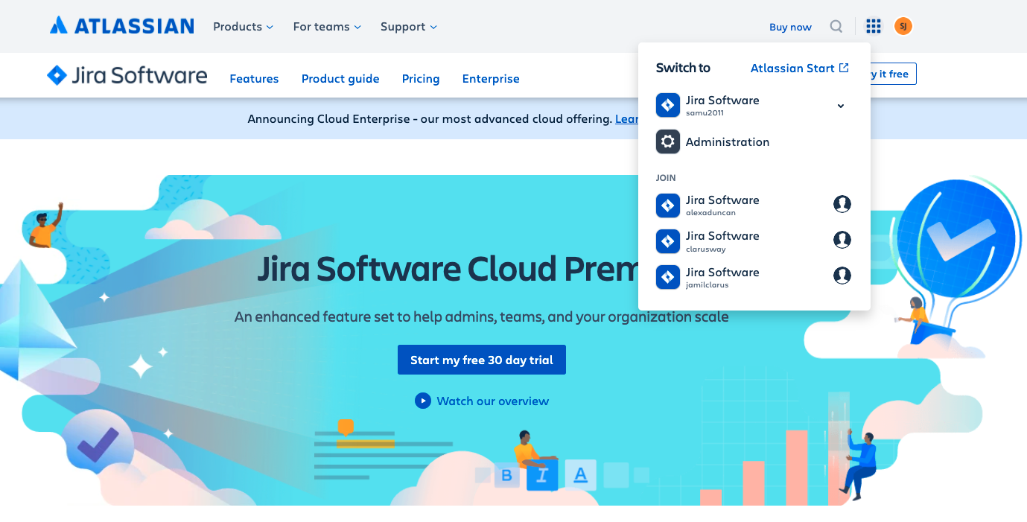
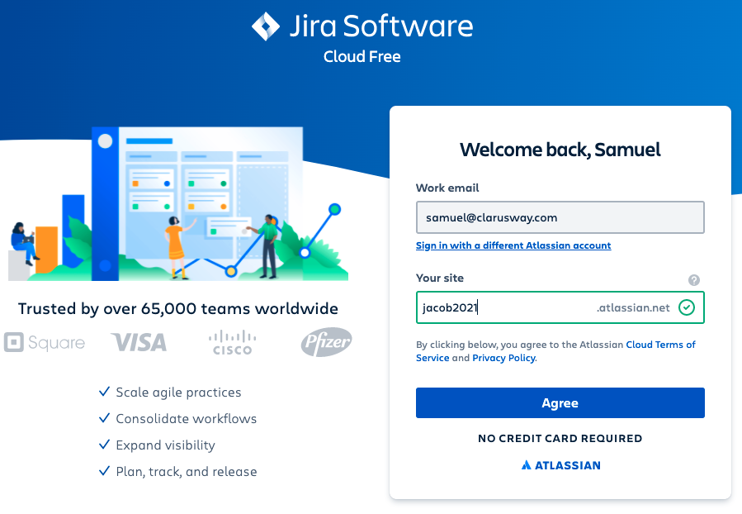
Setting up Jira Software Cloud
Notes:
We need an Atlassian account to use atlassian products.
First you have to create an account or
if you have already an account
you can create a workspace in jira software.
So there is a general account for Atlassian and
under this account you can use any of the
Atlassian products by creating workspaces.
this “your site” section is to create a workspace for you in jira software.
this will be your site on jira cloud.
After wring a unique name for your site, click on agree
I chose claruswayjira@atlassian.net
continue with the questions.

Slide 32
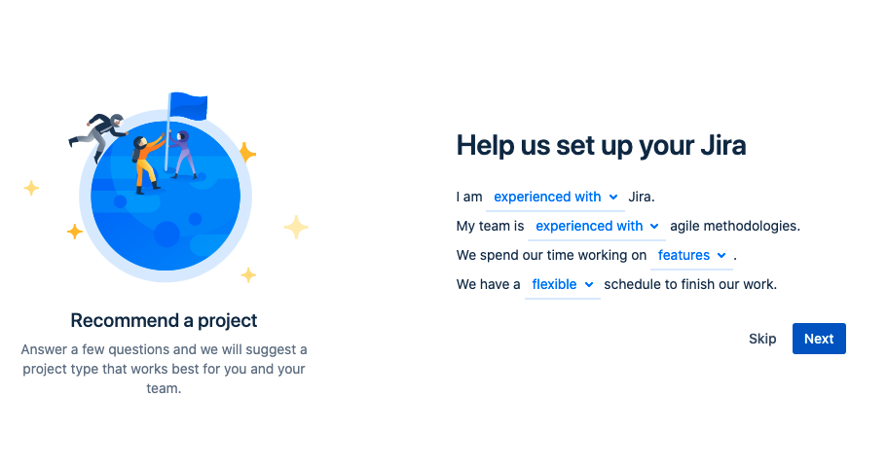
Setting up Jira Software Cloud
Notes:
Here jira will ask you some questions about yourself.
The details screen is updated, it won’t look the same

Slide 33
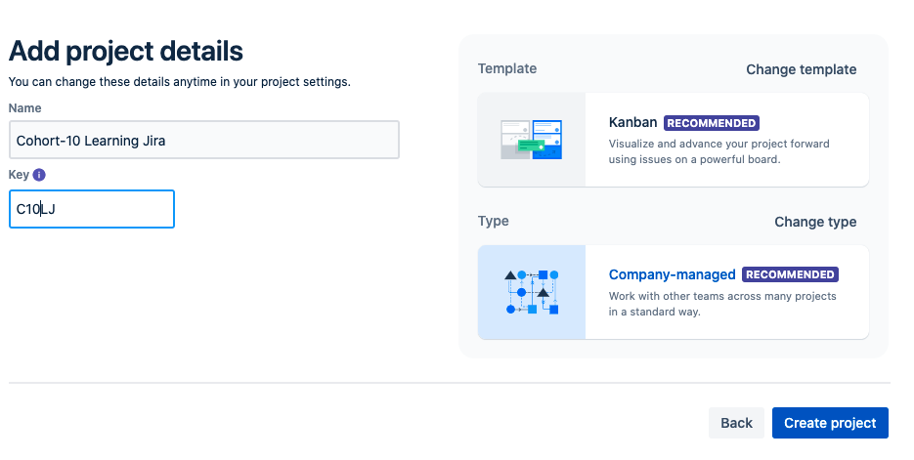
Setting up Jira Software Cloud
Notes:
After that you can add your project name and alias here.
and you can change template and type of the management type
First change the template

Slide 34
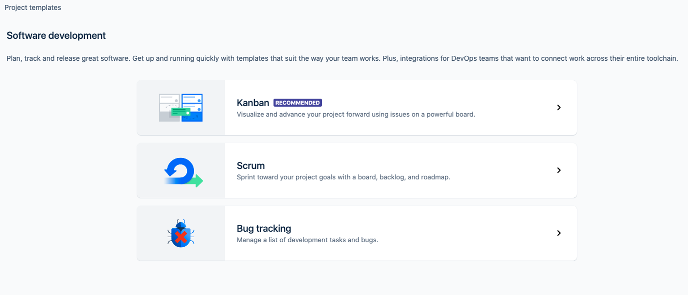
Setting up Jira Software Cloud
Notes:
For project templates there are 3 choices
Kanban- Scrum or Bug tracking
We’ll use Scrum based tracking

Slide 35
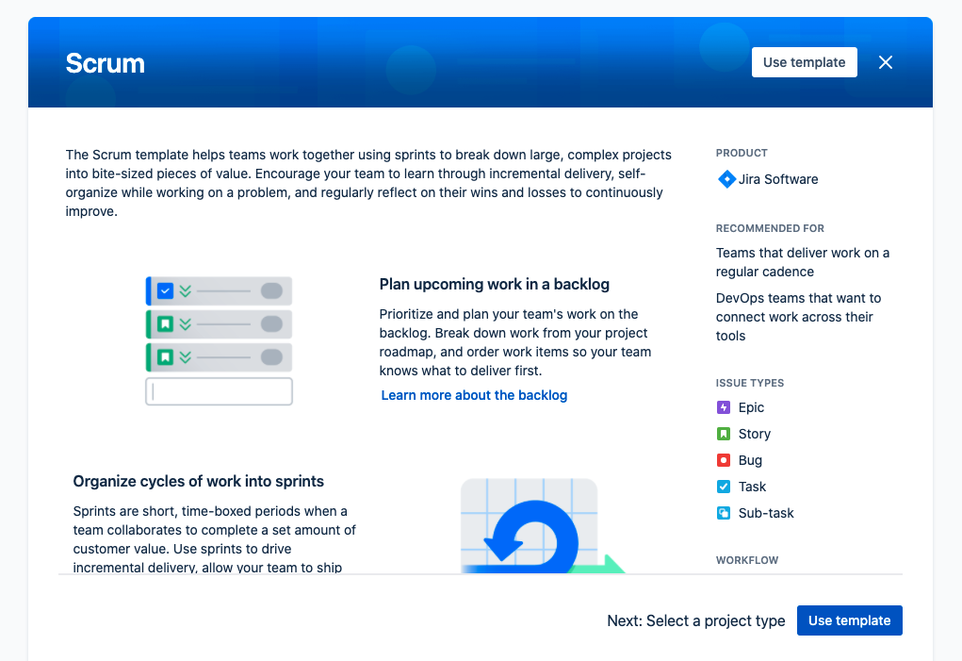
Setting up Jira Software Cloud
Notes:
You will see some information about scrum template
choose “use template”

Slide 36
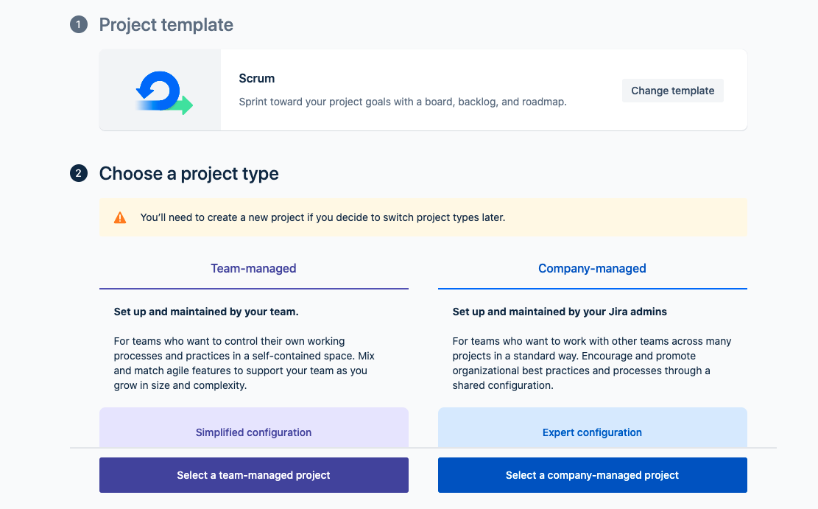
Setting up Jira Software Cloud
Notes:
After this you will see another menu to choose project type.
We will use team managed project from here.
Company managed project type is a little more complicated
You can add versions of issues,
you can deal with more reporting options.
for now we choose team managed projects

Slide 37
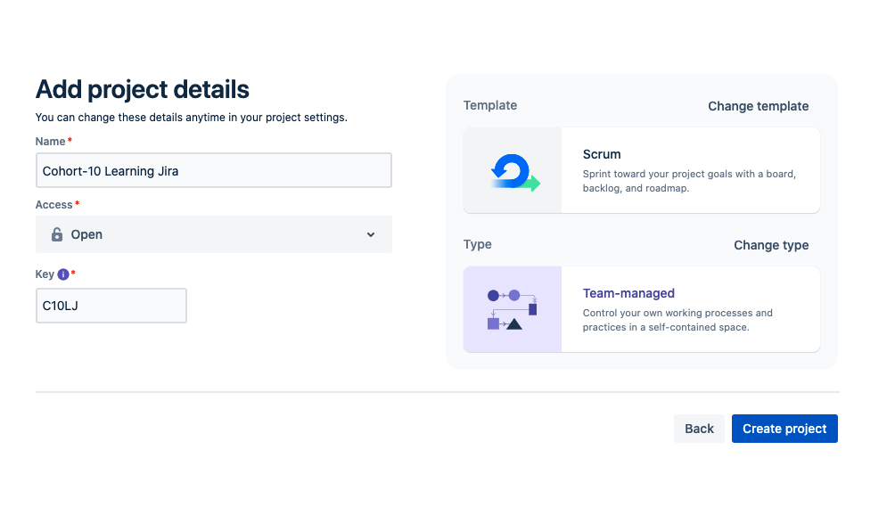
Setting up Jira Software Cloud
Notes:
Now you can see the changes we made
We selected Scrum for template and
team-managed for type.
Ok
Now we can create our project
We continued as such :
ClaruswayScrumWebProject
CLR

Slide 38
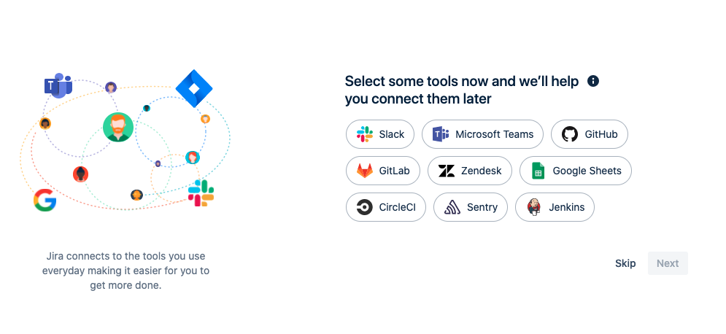
Setting up Jira Software Cloud
Notes:
After that it asks whether we want to make an integration with other tools
you can skip this .
Any time some tools can be integrated to the project.

Slide 39
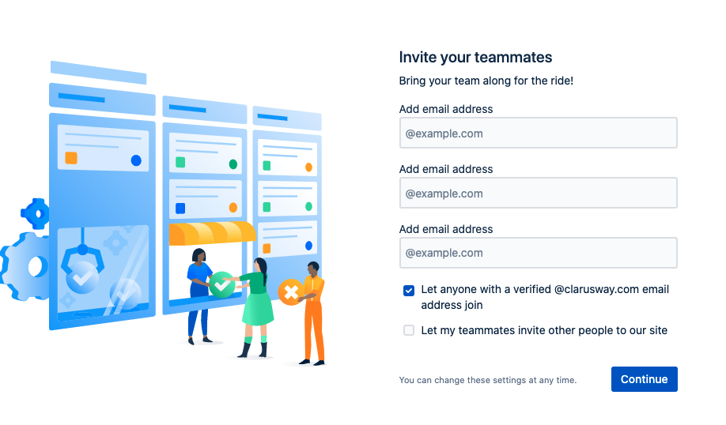
Setting up Jira Software Cloud
Notes:
This is for other team members you want to add to the project.
You can add now or later

Slide 40
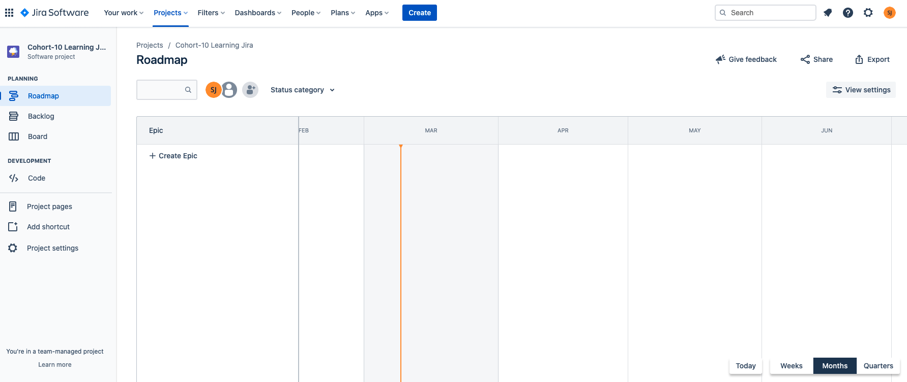
Setting up Jira Software Cloud
Notes:
Here it is
your project board in jira is ready to use
Now I will make it directly from jira

Slide 41
Navigating in Jira
5

Slide 42
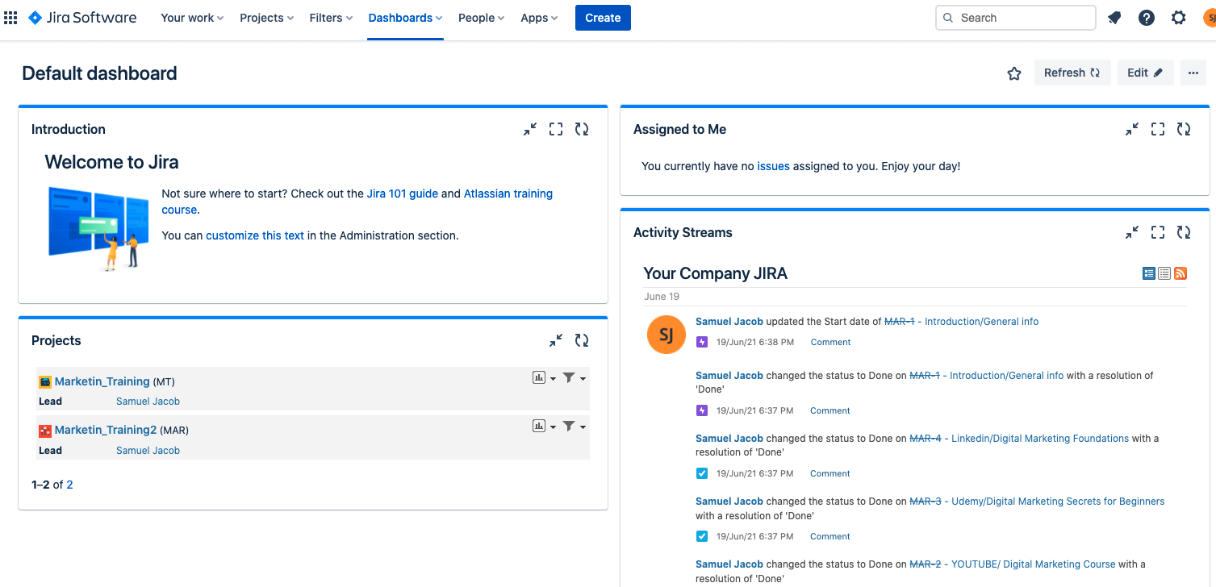
Navigating in Jira
Switch to
Company logo
Your work
Projects
Filters
Dashboards
People
Apps
Notes:
Display default dashboard:
https://claruswayjira.atlassian.net/jira/dashboards/10000
Depending on your permissions and how your Jira is set up, your Jira might look slightly different..
However, the basics of navigation are the same.
The first time you log into Jira, you'll see a dashboard like the one pictured.
And there is also dashboard button on upper menu.
when you click it your dashboard page opens.
This is an example of a default system dashboard.
This view helps you see useful data like issues assigned to you and activities that recently occurred.
The example shows that there are many issues assigned to me. I'd better get to work.
Your system dashboard probably looks slightly different.
Jira remembers the dashboard you accessed last,
so you might see a totally different dashboard instead.
You can also create your own custom dashboards.
You can change and customize it according to your needs

Slide 43
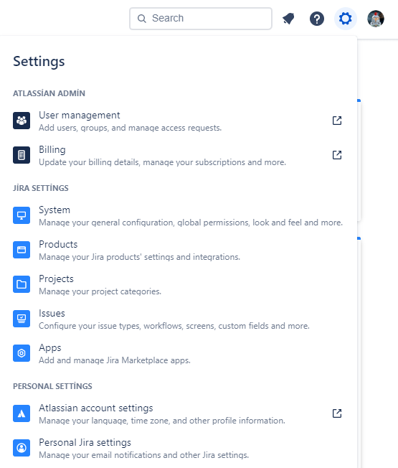
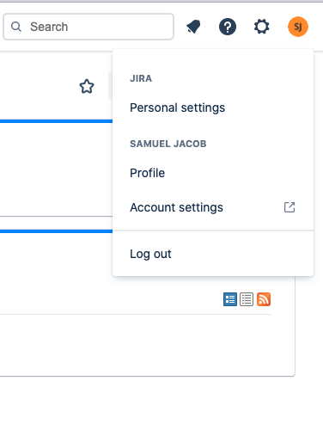
Settings & Profile
User management
Billing
System
Products
Projects
Issues
Apps
Personal Settings
Notes:
Open this settings and profile section, investigate one by one.

Slide 44
Jira Concepts
6
Notes:
Now lets talk about how we will implement scrum in Jira.
how we use epics,
user stories and tasks.
How we plan our sprints

Slide 45
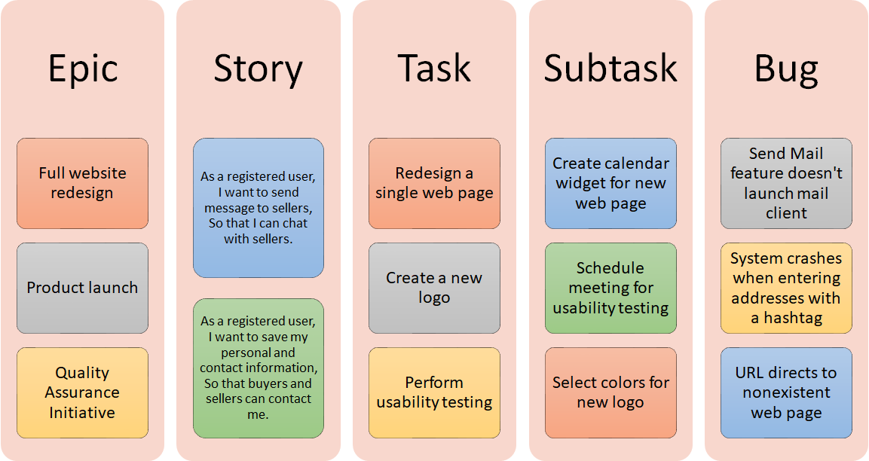
Examples for Issue Types

Slide 46
Issue Fields
Field | Description
Issue type | The issue types you can define in Jira Software are Story, Task, Bug, and Epic.
Summary | This field is marked with an asterisk, so you have to write a summary to create an issue.
Description | This field is where you write a description of your issue.
Fix versions | This field is used to indicate the future version in which the issue is resolved.
Labels | This field can be considered as a tag or keywords.
Environment | This field describes the environment of the issue.
Attachment | You can attach files to this field from your local drive or cloud storage provider.
Affects versions | This field describes in which version the bug exists.
Linked Issues | Using this field, you can link issues in your project.
Priority | This field describes the priority of the issue.
Assignee | This field represents the user who the issue is assigned to.
Epic Link | This field is a relational link to identify the parent epic of the issue.
Sprint | This field is used to add the issue to the sprint that you want to associate with.

Slide 47
Issue Priorities
The priority of an issue determines how important it is relative to other issues.
Priority | Description
Highest | This problem will block progress.
High | Serious problem that could block progress.
Medium | Has the potential to affect progress.
Low | Minor problem or easily worked around.
Lowest | Trivial problem with little or no impact on progress.

Slide 48
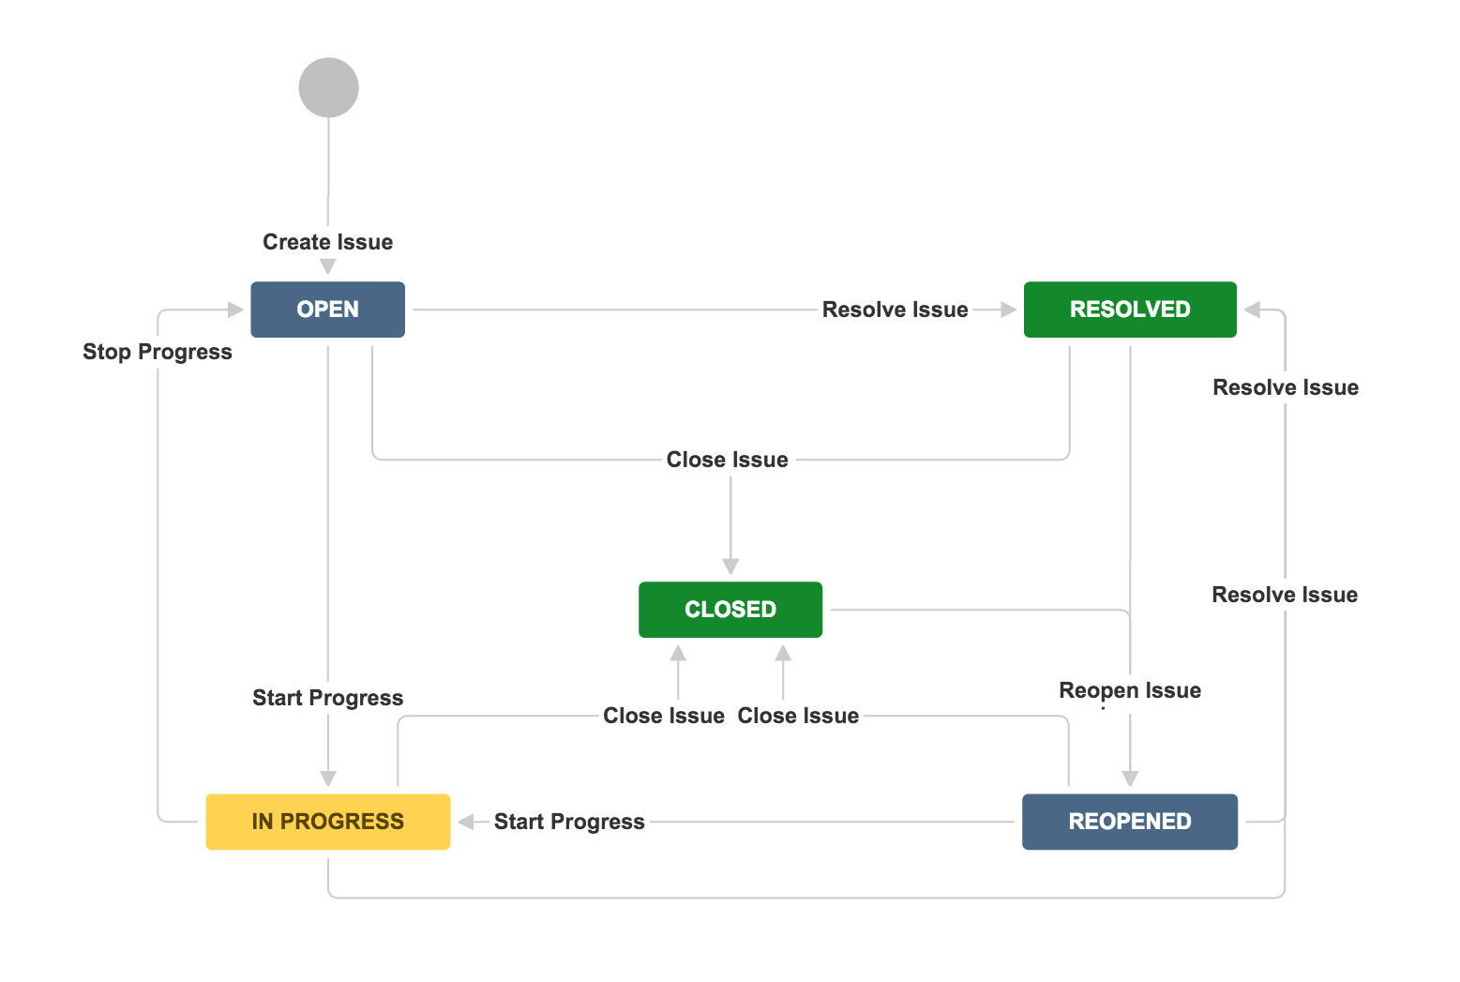
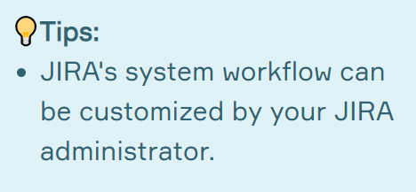
Issue Workflows
Status represents the stage of an issue at a particular time.
Transition is the link between two statuses that allows an issue to move from one status to another.

Slide 49
Jira Issue Hierarchy Levels
Structure your work in Jira
Initiative
from the largest objectives down to the minute details
Epic
Epic
Epic
Story/Task
Story
Task
Story
Task
Subtask
Subtask
Subtask
Subtask
Subtask
Subtask
Notes:
Let's assume that our virtual company has gained a large scale project.
To do this, you will need to structure your work from the largest goals to minute details.
You will want to report your progress and stick to a plan.
Initiatives, Epics, stories and tasks will be the tools needed to detail your business.
From scrum we know that there are epics, stories and tasks.
Jira adds some more issues on top and on bottom.
Initiatives are collections of epics that drive toward a common goal.
Maybe in a small project one epic may be enough.
You don't need to use initiatives.
The initiative hierarchy level, on the other hand, is not included in the default hierarchy
You can add it as an issue type according to the needs of your projects.
But in big projects there may be more epics.
Epics: are large bodies of work that can be broken down into a number of smaller tasks (called stories).
Stories: also called “user stories,” . What was user story?
They are short requirements or requests written from the perspective of a customer.
Tasks and Subtasks - Work components that make up the stories.

Slide 50
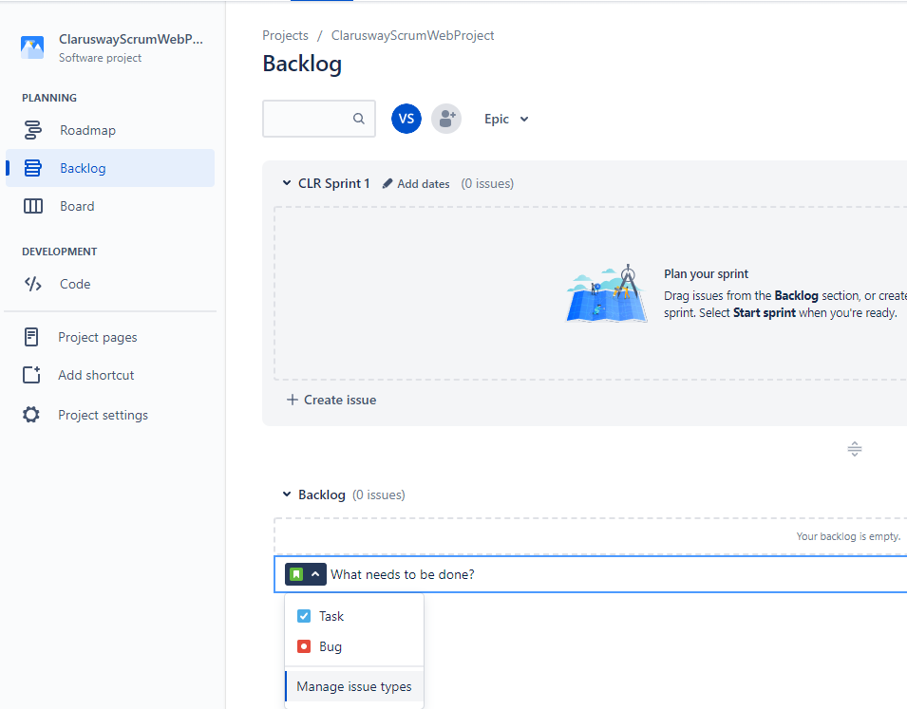
Jira Issue Hierarchy Levels
Notes:
Manage issue types here opens up a designer to add new issue types such as “Initiatives”.

Slide 51
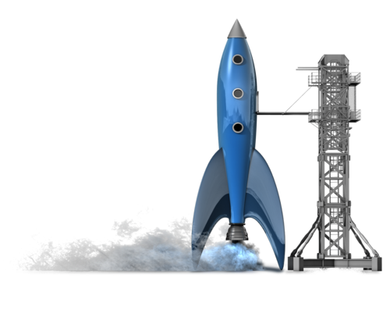
Which one is named as collection of epics that drive toward a common goal?
Notes:
🍐 This is a Pear Deck Multiple Choice Slide. Your current options are: A: Theme, B: Initiative, C: Story, D: Task,
🍐 To edit the type of question or choices, go back to the "Ask Students a Question" in the Pear Deck sidebar.
Which one is named as collection of epics that drive toward a common goal?

Slide 52
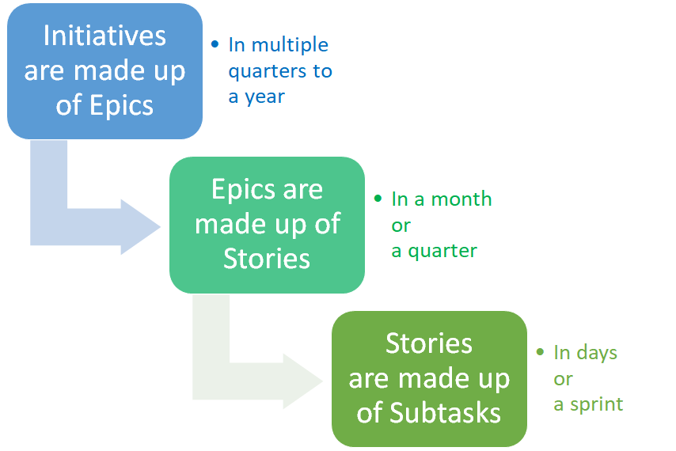
Jira Structure
Notes:
Initiatives are collections of epics
Epics can be finished in one or 3 months time
On an agile team, stories are
something the team can commit to finish within a one or two-week sprint.
Developers would work on dozens of stories a month.
Epics, in contrast, are few in number and take longer to complete.

Slide 53

………. are large bodies of work that can be broken down into a number of smaller stories.
Notes:
🍐 This is a Pear Deck Multiple Choice Slide. Your current options are: A: Epics, B: Stories, C: Tasks, D: Subtasks,
🍐 To edit the type of question or choices, go back to the "Ask Students a Question" in the Pear Deck sidebar.
Epics

Slide 54




Jira Structure
Initiative
Collections of epics that drive toward a common goal
Epic
Big chunk of work that has one common objective
Story
Short requirements written from the perspective of an end user.
Task/
Subtask
Smaller piece of story
Notes:
Summing up

Slide 55






Jira User Types
Jira Administrator
Jira Project Administrator
Team Member
Configures the Jira instance for all users
Configures the Jira project to match the team’s process
Works on Jira projects
Notes:
There are 3 main user types in Jira.
Jira Administrator has the most capability inside of Jira.
Jira Admin controls all access to Jira applications and what users can do in Jira.
Project Administrator.
In general a Jira Project Administrator only has permission to configure specific projects.
Team members who are working inside of Jira.

Slide 56




Jira User Types
COMPANY
A few Jira Administrator
One or more Project Admin for each project
Many Team Members
Notes:
Jira Administrator has the most capability inside of Jira.
Jira Project Administrator only has permission to configure specific projects.
Team members who are working inside of Jira.

Slide 57

Who controls what Jira products you have access to and what you can do in Jira?
Notes:
🍐 This is a Pear Deck Multiple Choice Slide. Your current options are: A: Your Manager, B: You, C: Jira Administrator,
🍐 To edit the type of question or choices, go back to the "Ask Students a Question" in the Pear Deck sidebar.
Jira Administrator

Slide 58
Jira Integrations
7

Slide 59
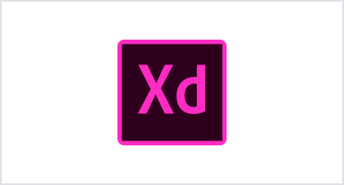















Jira Integrations
Software Engineering teams
Design teams
IT teams
Business teams
Notes:
Jira has 1000's of integrated applications in Atlassian Marketplace.
Most of these integrations are free and easy to install.
Slack, GitHub, Zendesk Jenkins Github Opsgenie Miro Trello Microsoft Teams Google Sheets
Design teams
IT teams
Business teams
Software Engineering teams
can integrate those applications as the needs of their projects.

Slide 60






Funny Moment
Notes:
🍐 This is a Pear Deck Web Slide.
🍐 To edit the type of question, go back to the "Ask Students a Question" in the Pear Deck sidebar.
These are some tweets about Jira some jogs about.
They make fun actually
A Jira ticket assigned to you means you have a new work to do.
So there are common jokes about jira ticket in IT world.

Slide 61



How well did you like this lesson?
Notes:
Temperature Check
Get a sense for how well your lesson resonated with your students, or how engaged they were.
🍐 This is a Pear Deck Draggable™ Slide.
🍐 To edit the type of question, go back to the "Ask Students a Question" in the Pear Deck sidebar.

Slide 62
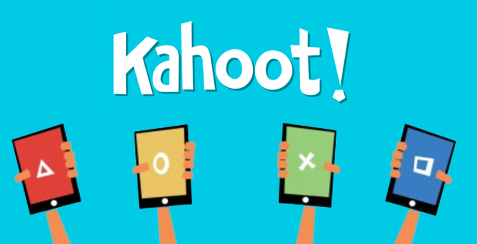

Slide 63

THANKS!
Any questions?
You can find me at:
@volkan
volkan@clarusway.com

